Slide 1
UML DIAGRAMS
SKILLNECT

Slide 2
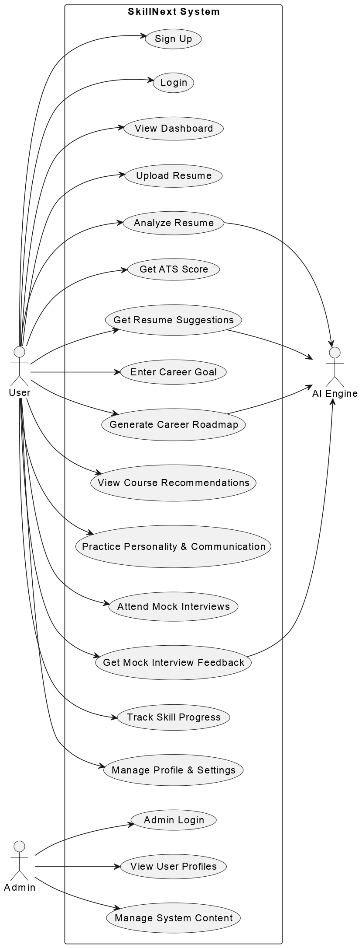
SkillNect – Use Case Diagram

Slide 3
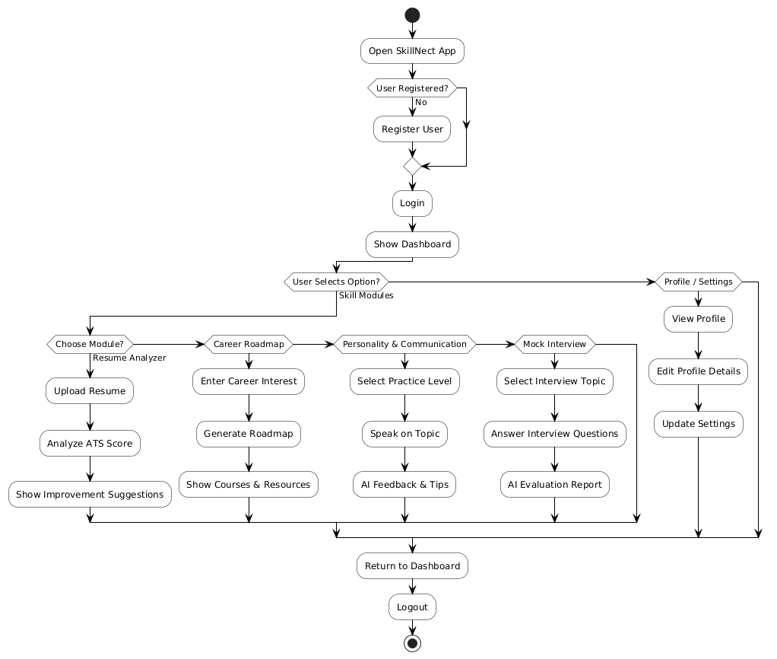
SkillNect Activity Diagram

Slide 4
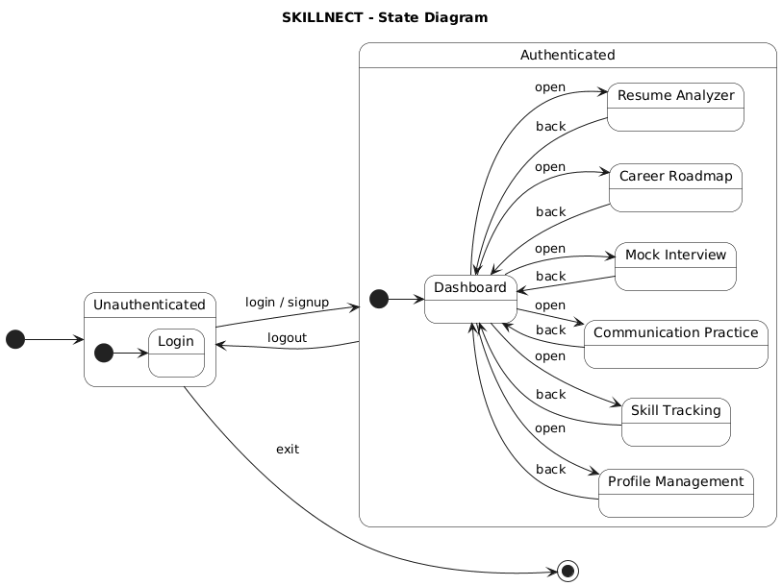

Slide 5
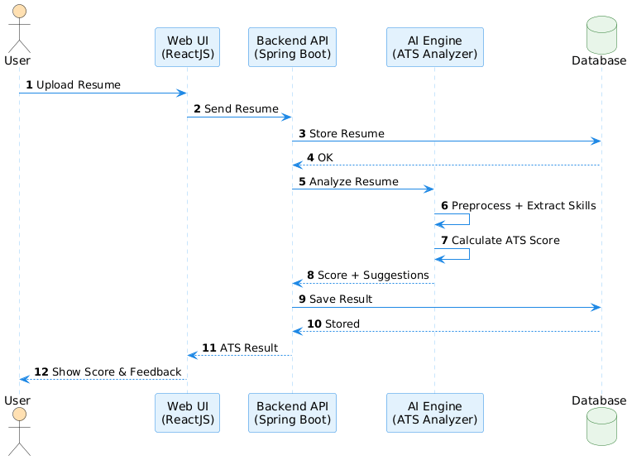
SkillNect – Sequence Diagram

Slide 6
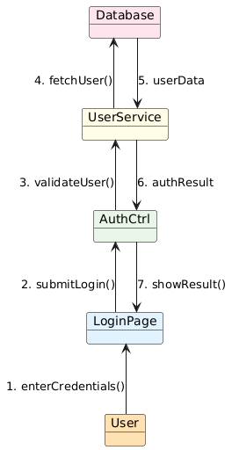
SkillNect – Communication Diagram

Slide 7
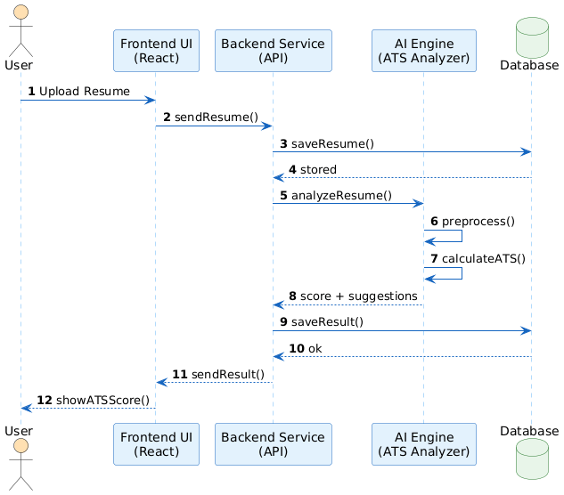
SkillNect Interaction Diagram

Slide 8
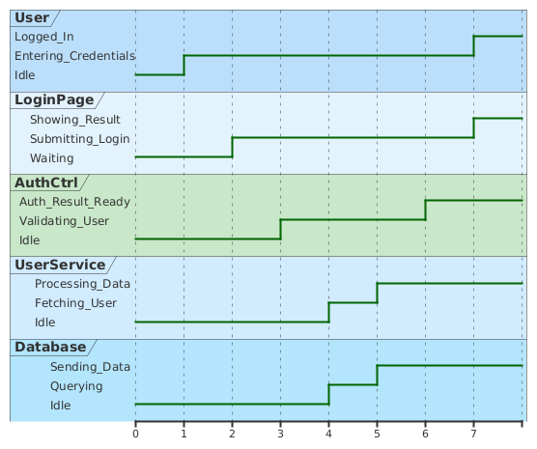
SkillNect – Timing Diagram

Slide 9
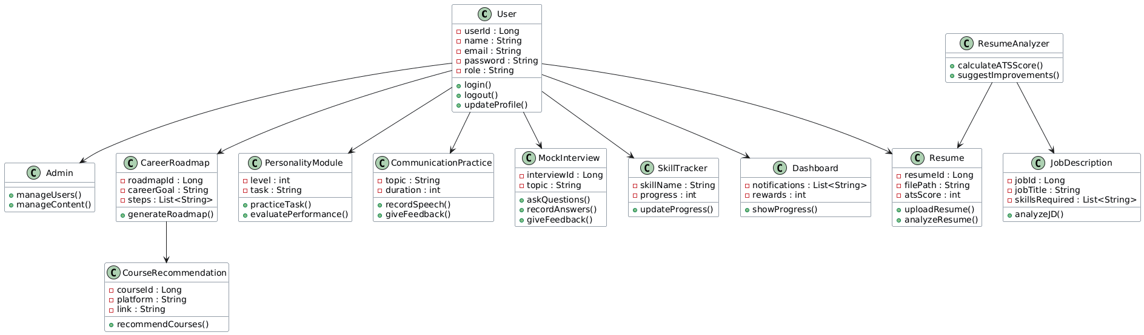
SkillNect – Class Diagram

Slide 10
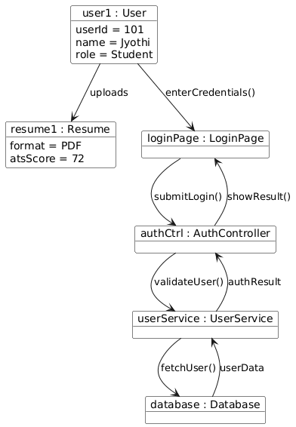
SkillNect – Object Diagram

Slide 11
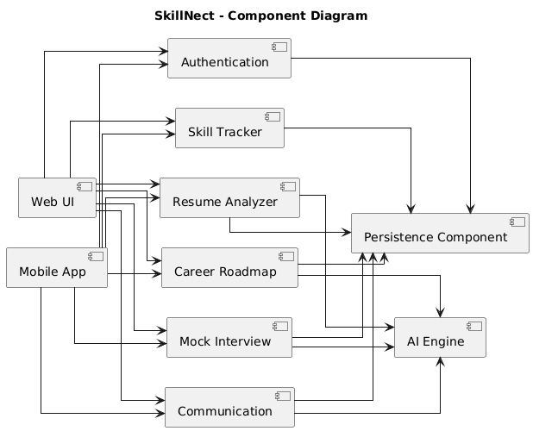

Slide 12
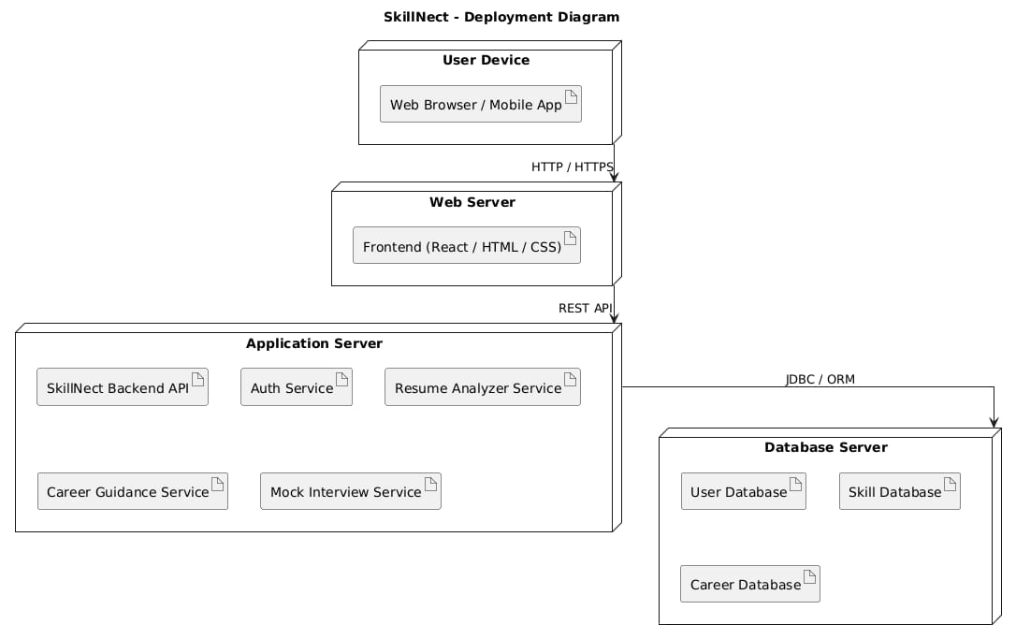

Slide 13
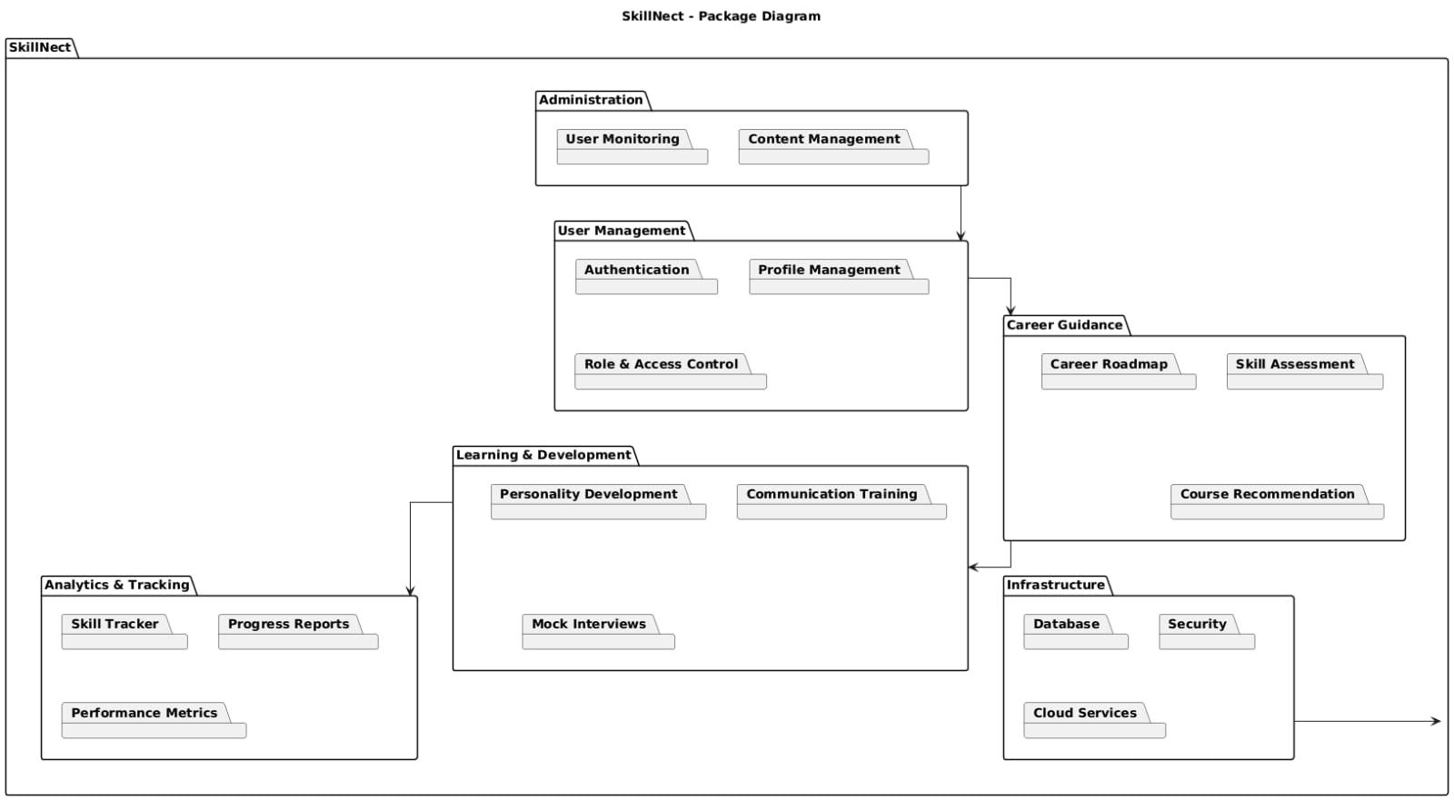

Slide 14
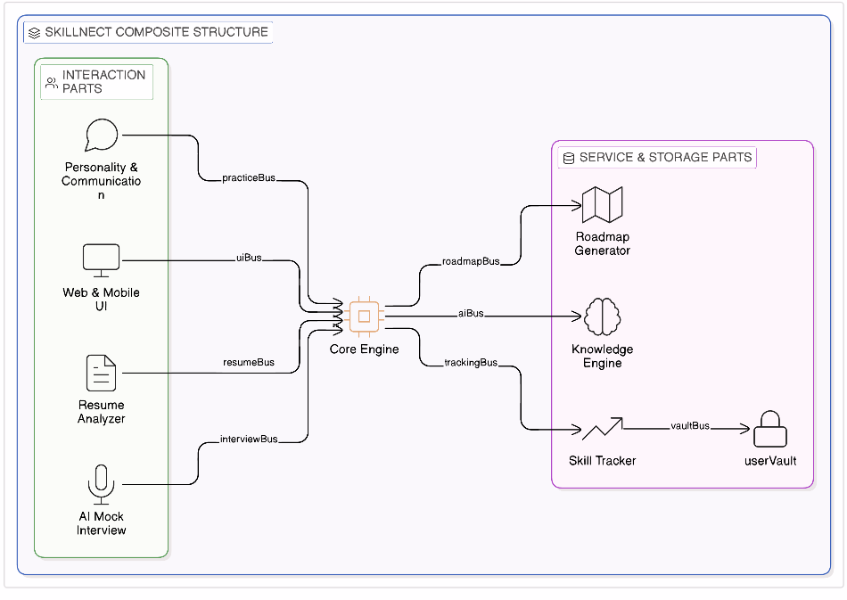

Slide 15
